Slide 1
Defense Sector

Slide 2

The Clip-Lok SimPak Group

Slide 3
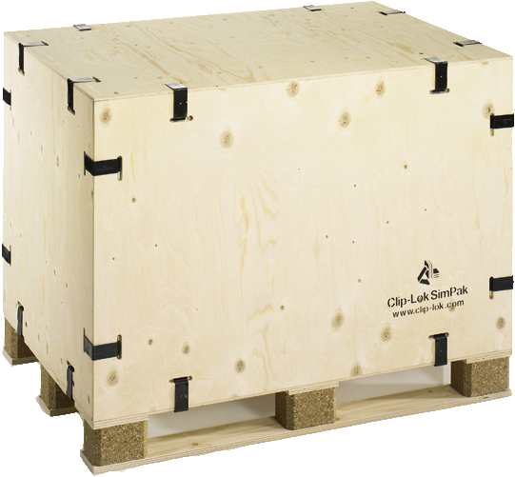
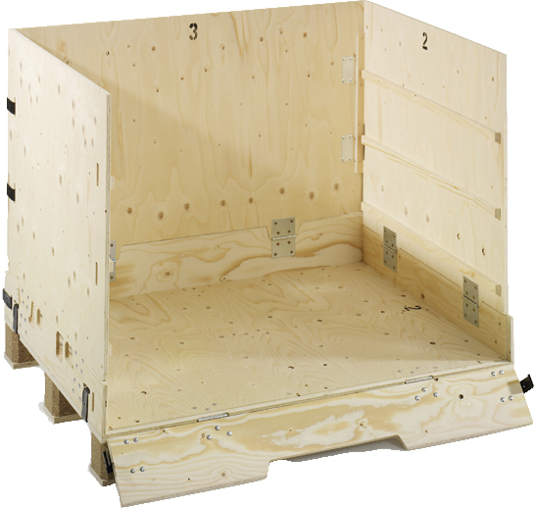
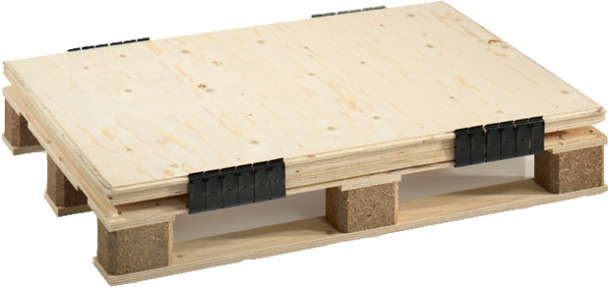
Company history
The Clip-Lok SimPak® system was developed in Canada in 1982
Clip-Lok SimPak® International Limited acquired the company in November 1989
Patents and/or trade marks are now registered or pending in more than 70 countries

Slide 4

A global packaging group
Production, sales and marketing on four continents – North America, Europe, Africa and Asia – so we can provide service to companies across the globe.
UK
Benelux
Scandinavia
Hungary
USA
Spain
Portugal
Israel
Korea
Thailand
India
South Africa

Slide 5
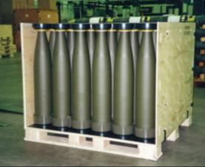
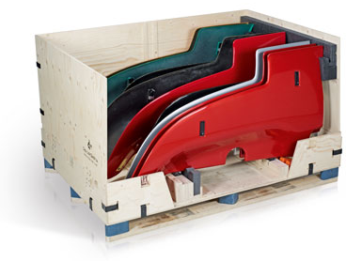
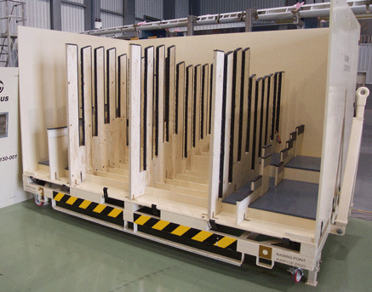
Key segments
Defense
        Automotive
                Aeronautics

Slide 6
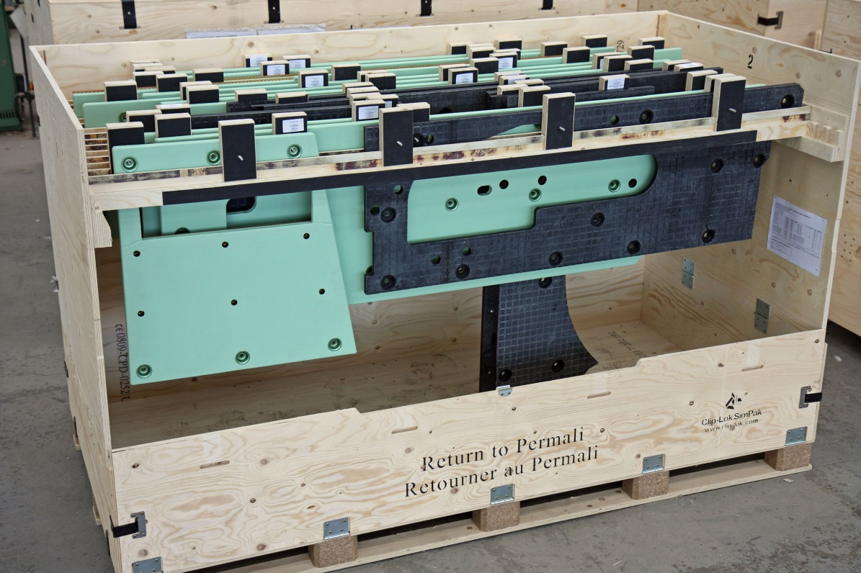
Why have hundreds of companies around the world chosen Clip-Lok?

Slide 7
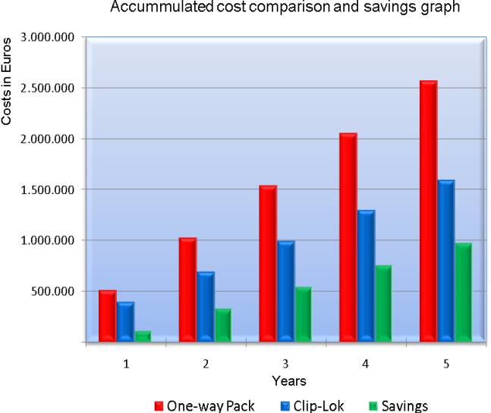
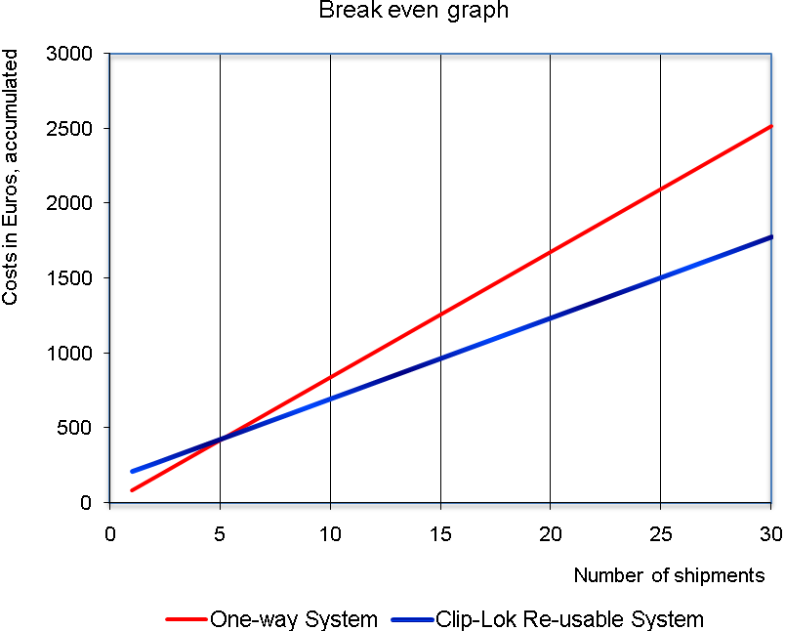
Cost effectiveness
By choosing a Clip-Lok reusable packaging system instead of a one-way system, you can significantly reduce your costs.
Fast return on investment - often after just three trips
Very low maintenance costs
Minimal return shipping and storage costs due to flat-packing
No waste disposal costs at the end of each trip
Custom dunnage design ensures maximum cargo
protection to eliminate damage costs

Slide 8
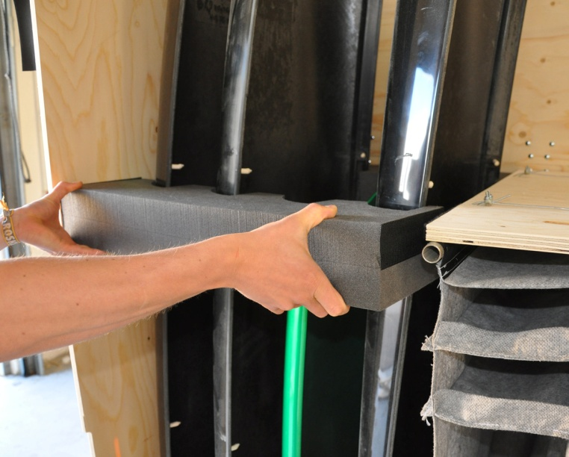
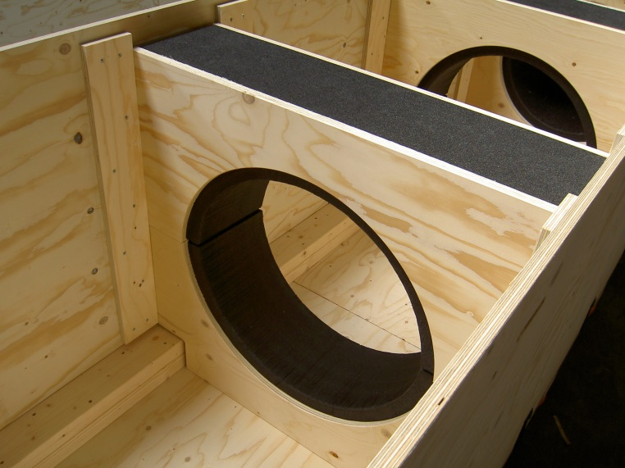
Experience and support
Over 25 years of experience
Global support network on four continents
  International customer support at the point of dispatch and on arrival

Slide 9
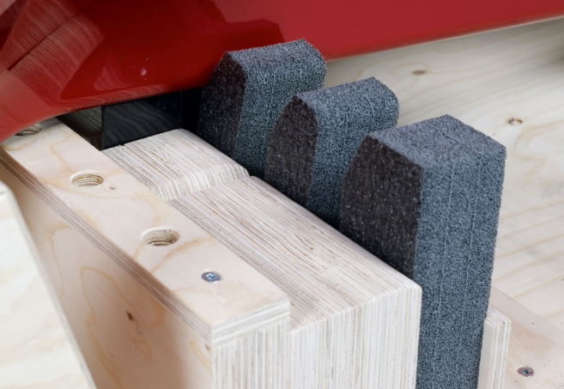
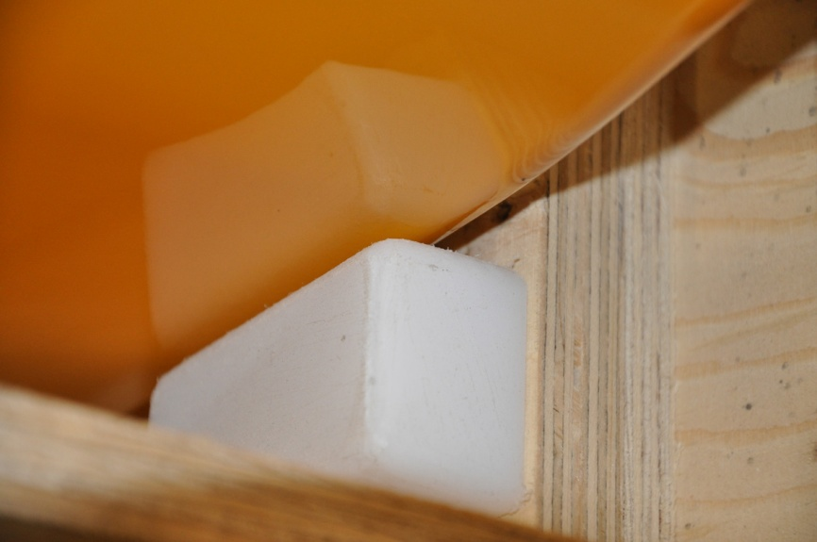
Quality
Extensive quality testing
Numerous certifications
Superior reliability and strength
Custom design

Slide 10













References
GENERAL MOTORS COMPANY

Slide 11
The Clip-Lok box

Slide 12
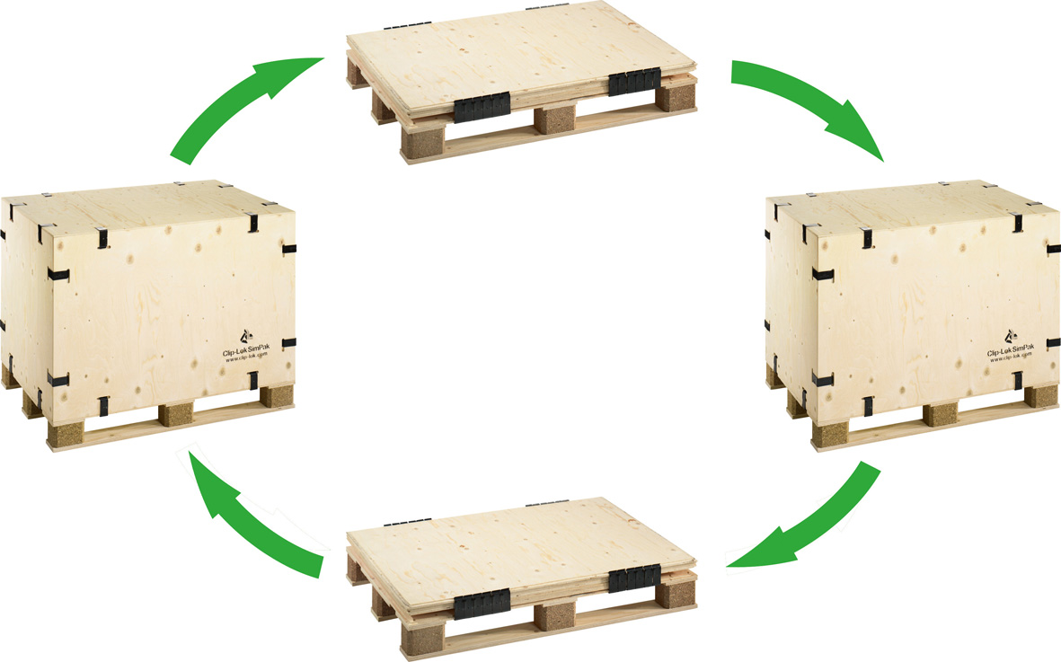
Flatpackable and reusable
From assembled to flatpacked in under two minutes
All components of a flatpacked box are contained in one unit
A flatpacked box is up to 80% smaller than an assembled box

Slide 13
Clip-Lok box material
FCS, PEFC and ISPM15 certified plywood
Strong and flexible
Smooth clean surface
Weather resistant
Low maintenance costs - All parts can be replaced individually

Slide 14
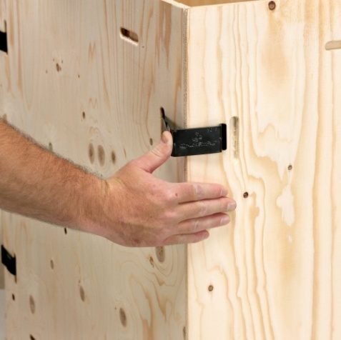
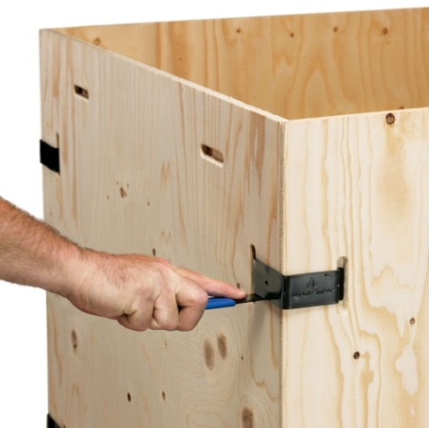
The Clip-Lok clip
Made of the highest quality spring steel
100% elastic behavior
Tensile strength of up to 11,000 kg
Surface protected with a high quality coating
Can withstand a salt spray test for more than 250 hours
Tested and approved down to -50°c for use in arctic climates
Tested and approved for other extreme weather conditions

Slide 15
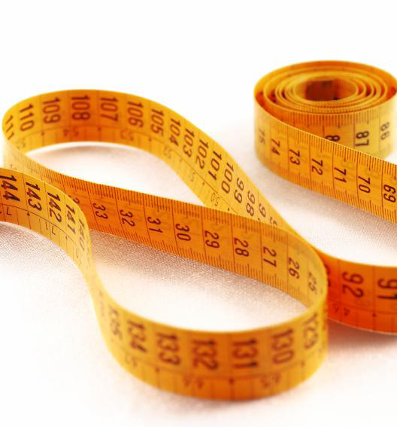
Custom design
Our experienced design teams will cooperate with you to meet your specific needs, including:
Weight, volume and fragility of the product
Loading plan
Means and distance of transport
Stacking requirements
Inner shelving and other special dunnage

Slide 16
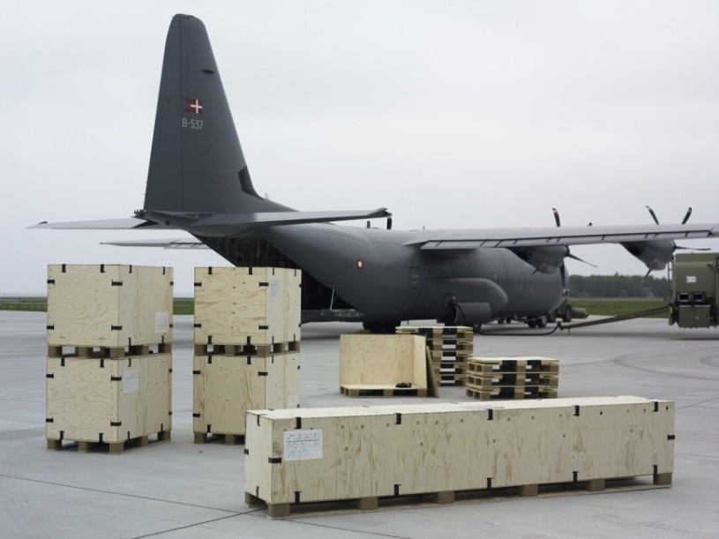
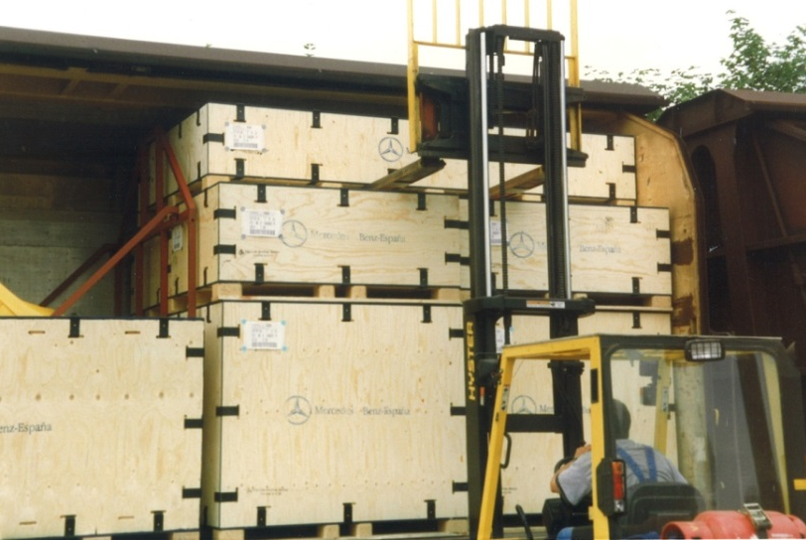
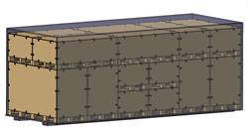
Transport
Custom box size can be optimized for transport by:
  Air
  Sea
  Rail
  Road

Slide 17
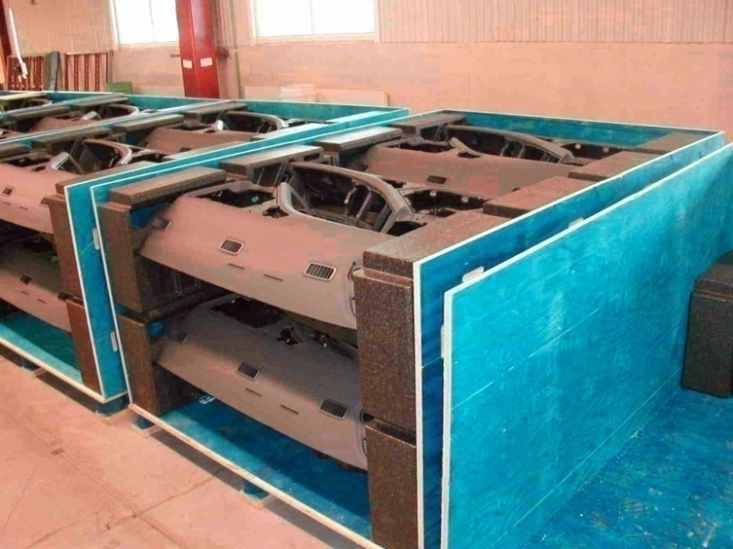
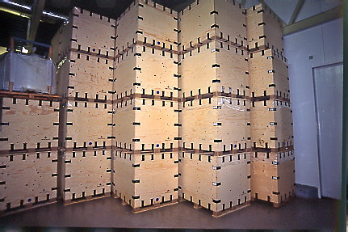
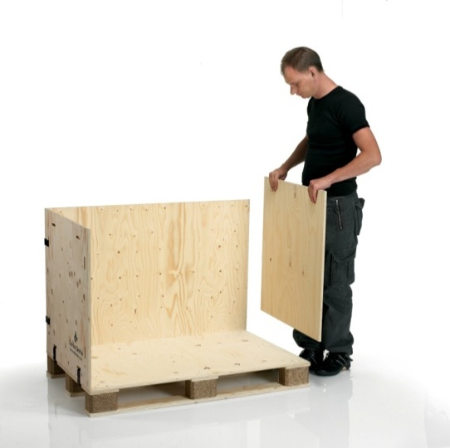
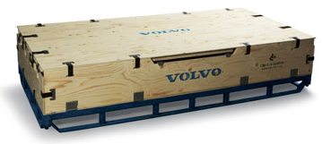
Storage and handling
Assembled and dismantled by one person in just a few minutes
Loaded boxes can be stacked without racking
Empty boxes can be collapsed, flatpacked and stacked, saving up to 80% space and saving costs
The boxes can be a part of the production line, optimizing the work flow and saving time

Slide 18
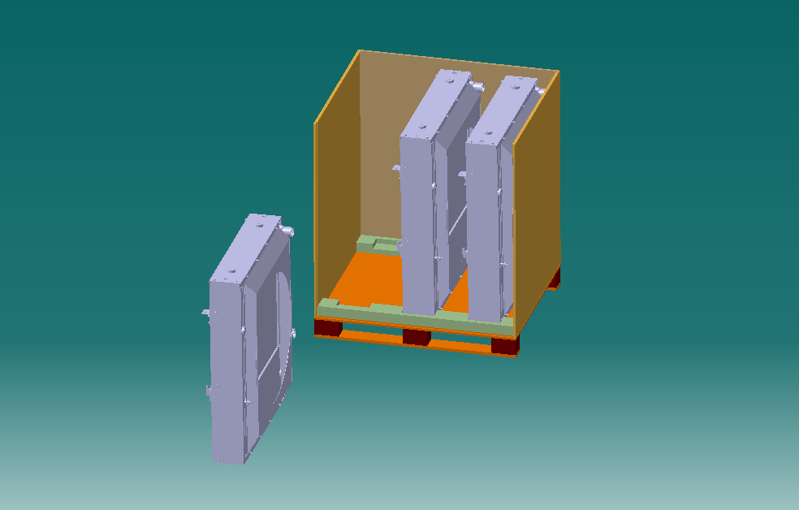
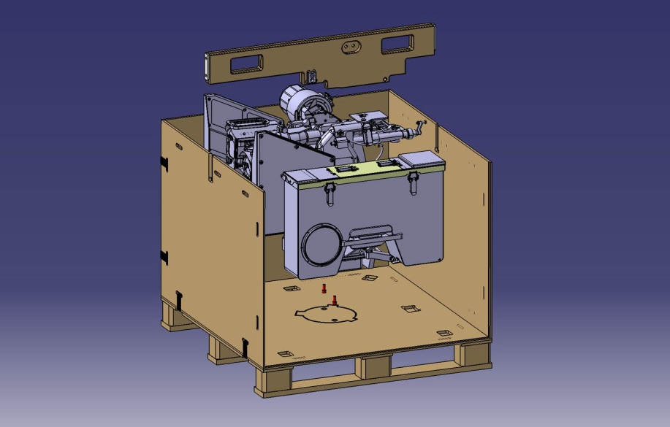

3D integrated development
The box design is simulated in a 3D program such as CATIA
Allows us to determine packing density without using physical parts
Allows fast handling of inquiries
Based on the simulation and acquired knowledge, a prototype can be ordered for testing

Slide 19
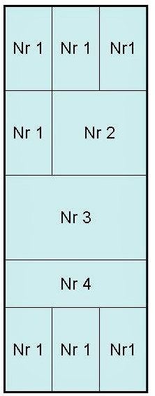
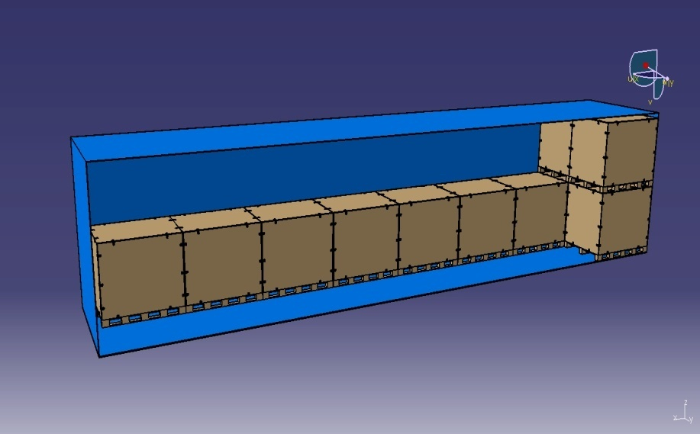
Pack plans
Pack plans can be provided upon request
Boxes can be designed to match all kinds of transport methods

Slide 20
Feasibility study
Clip-Lok is able to calculate:
Your cost savings when using the reusable Clip-Lok system instead of one-way boxes
The possibilities to increase the numbers of parts and boxes per shipment
Potential cost savings when optimum dunnage is designed

Slide 21
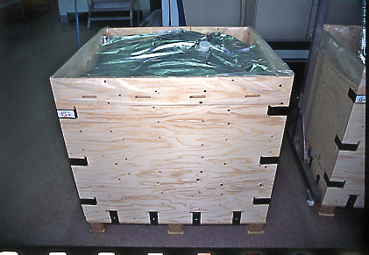
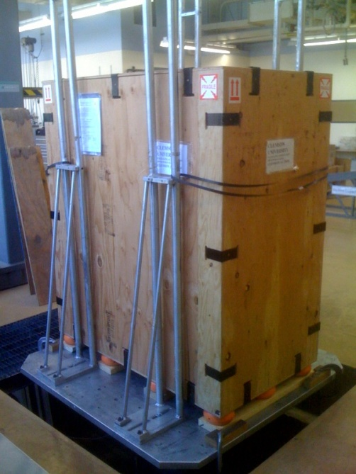
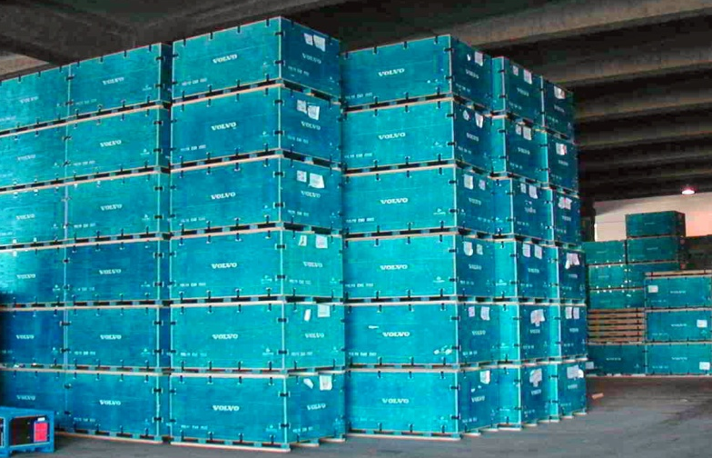
Tests
Clip-Lok boxes have been successfully tested by official test institutes around the world. Tests include:
Pressure of up to 15 tons
Transport of 1,000 liters liquid
Stacking up to ten high when loaded
Transport of hazardous goods
  MIL-STD
  ICAO standards
  ADR/RID test
  IMDG standards
Vibration durability
Drop durability
Weather resistance
Impact durability

Slide 22
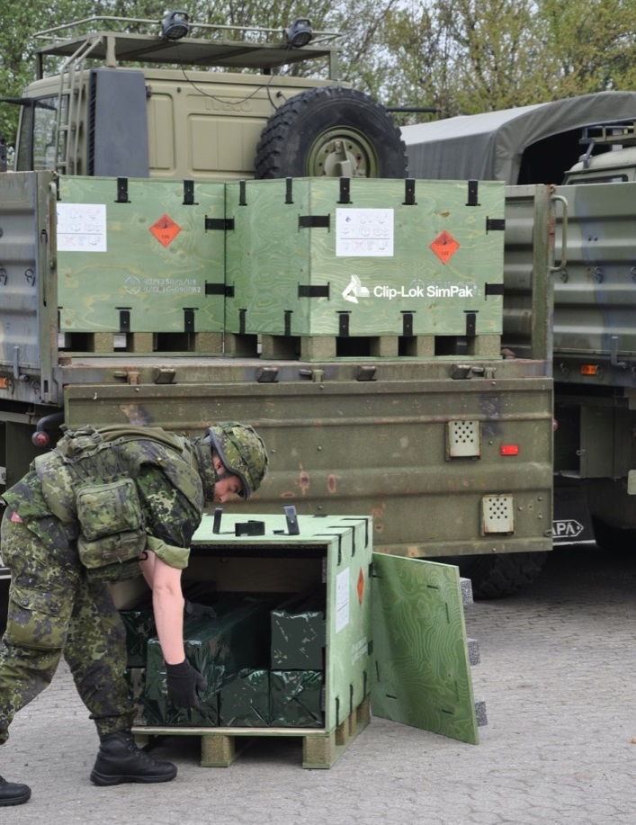
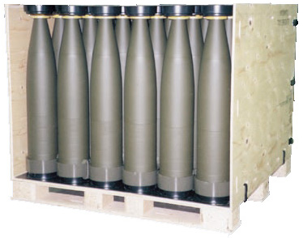
Certifications and approvals
Clip-Lok has obtained many international approvals including:
ISO 9000 or equivalent awarded in a number of countries
United Nations approval for the transport of dangerous/hazardous goods
Armed Forces accreditation in a number of countries
Our vendors are certified according to ISO 14001
ISPM15

Slide 23
NATO stock numbers
NATO Stock No. | Origin country | Application | Internal Dimensions | Material | UN Class. No.
8145 22 606 57 64 | Scandinavia | Miscellaneous | 1176 x 776 x 776 mm | 12 mm plywood
8145 22 127 02 51 | Scandinavia | Tents | 1426 x 1126 x 847 mm | 12 mm plywood
9999 22 602 70 81 | Scandinavia | Miscellaneous | 776 x 576 x 576 mm | 12 mm plywood
7125 22 602 70 79 | Scandinavia | Shelving for CL DANI 001 | 1176 x 776 x 807 mm | 12 mm plywood
8115 22 309 22 18 | Scandinavia | Miscellaneous for arctic use | 1176 x 776 x 776 mm | 12 mm phenolcoated plywood
8115 22 600 41 82 | Scandinavia | Miscellaneous | 1176 x 776 x 592 mm | 12 mm phenolcoated plywood
8115 22 600 41 78 | Scandinavia | Miscellaneous | 1176 x 776 x 776 mm | 12 mm plywood - blue
8115 22 604 44 12 | Scandinavia | AC-M7 air conditioning | 998 x 800 x 1357 mm | 12 mm plywood
8145 22 607 92 91 | Scandinavia | Cabinet box | 776 x 776 x 1140 mm | 12 mm plywood
9999 22 612 46 38 | Scandinavia | Cabinet box | 776 x 592 x 1140 mm | 12 mm plywood
8115 22 612 91 19 | Scandinavia | VA-M40 heating | 1428 x 726 x 1015 mm | 12 mm plywood
5120 17 117 45 23 | Scandinavia | Tool to take off the clips |  | Springsteel - Hardened
5340 17 117 45 22 | Scandinavia | Clips to close the box |  | Springsteel - Hardened
8115 33 203 04 20 | Spain | Miscellaneous | 600 x 800 x 700 mm | 18 mm plywood | UN 4D/Y(250)/S/04
8115 33 203 04 11 | Spain | Miscellaneous | 1200 x 800 x 700 mm | 18 mm plywood | UN 4D/Y(300)/S/04
8115 33 203 04 12 | Spain | Miscellaneous | 2400 x 800 x 700 mm | 18 mm plywood | UN 4D/Y(400)/S/04
8115 22 621 91 14 | Scandinavia | Refrigerator | 810 x 860 x 2000 mm | 12 mm plywood
8115 22 612 91 15 | Scandinavia | Dish washer | 740 x 690 x 1450 mm | 12 mm plywood
8115 22 612 91 25 | Scandinavia | Washing machine | 680 x 600 x 900 mm | 12 mm plywood
8115 22 612 91 21 | Scandinavia | Water treatment | 1185 x 790 x 620 mm | 12 mm plywood
8115 22 612 91 16 | Scandinavia | Vacuum cleaner | 750 x 730 x 1120 mm | 12 mm plywood
8115 22 612 91 18 | Scandinavia | Tent poles | 3574 x 576 x 576 mm | 12 mm plywood
8115 22 612 91 17 | Scandinavia | Tent doors | 2800 x 1120 x 576 mm | 12 mm plywood
8145 22 617 82 67 | Scandinavia | Powertrain | 3090 x 2300 x 1190 mm | 18 mm plywood
8115 22 623 17 97 | Scandinavia | Misc. air drop box | 1076 x 1076 x 1147 mm | 12 mm plywood
8115 22 623 17 98 | Scandinavia | Misc. air drop box | 1036 x 496 x 443 mm | 12 mm plywood
8145 01 582 43 76 | USA | Fuel cells | 63 x 53 x 23 inches | 3/4 inch plywood

Slide 24
UN approvals
Continued

Slide 25
UN approvals

Slide 26

Environment
Less environmental impact than that of comparative one-way packaging
Made of FSC, PEFC and ISPM15 certified wood
Non-toxic glue
Recyclable materials
Durability, reusability and flatpack-ability reduces costs and pollution

Slide 27
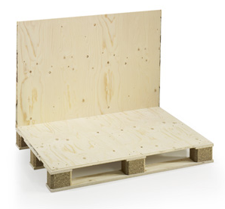
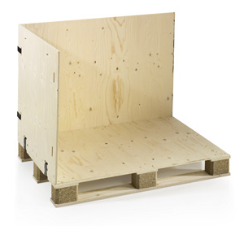
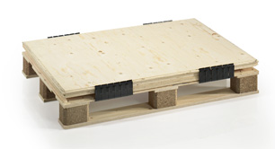
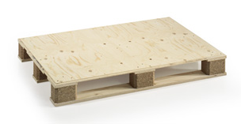
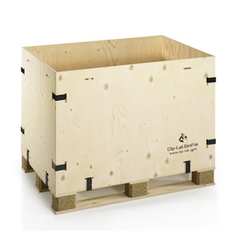
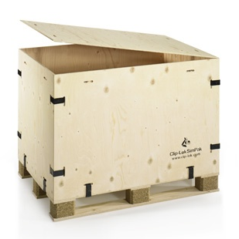
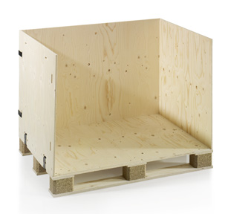
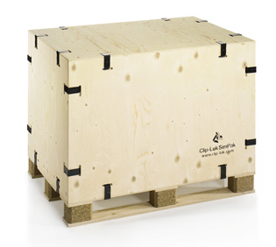
The Clip-Lok Standard box

Slide 28
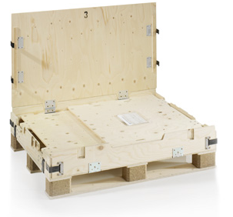
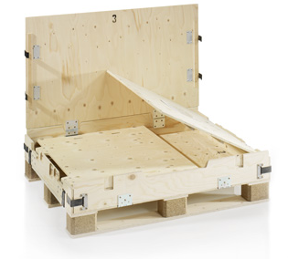
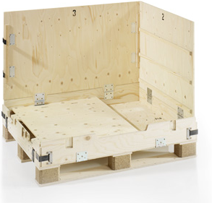
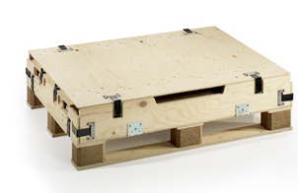
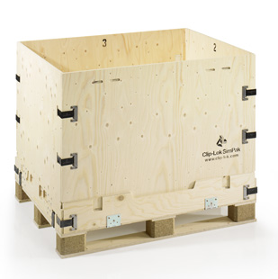
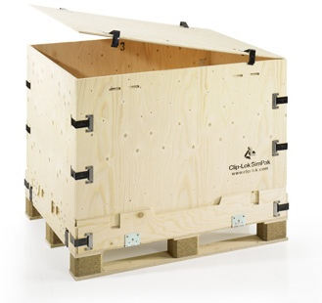
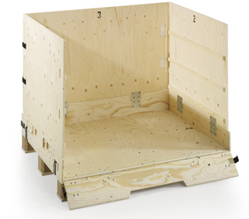
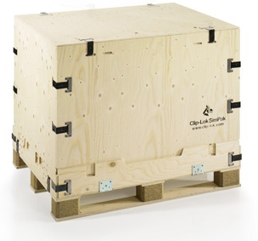
The Clip-Lok 2P box

Slide 29
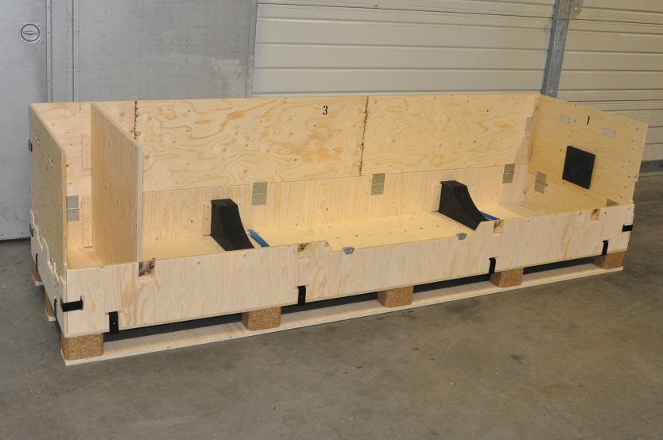


Advantages of the 2P box
Only two loose parts – lid and front panel
Hinged panels and clips
The dunnage folds into the box when flatpacked
Fast and easy handling

Slide 30

Dunnage

Slide 31


Clip-Lok dunnage
Custom designed for each assignment
Ensures safe transport of any type of item including:
  Sensitive electronics
  Hazardous goods
  Large panels
  Heavy and bulky parts
High packing density – optimized space usage within the box

Slide 32



Dunnage materials
Wide range of dunnage materials including plywood, steel, plastic, PUR and foam
Combinations of various materials
Chosen according to the items to be transported and the means of transport

Slide 33



Integrated dunnage
No loose parts
Reduced pack and unpack times
All parts are contained in the flat-packed box

Slide 34




Other dunnage solutions
Self-supported construction
Supportive blocks
Loose dunnage
Shelving

Slide 35



Soft-Rack dunnage
Optimizes packing
No need for extra packaging due to the protective fabric shelving
Immediate access and handling
2P box dunnage folds into the box when it is flatpacked

Slide 36

Deployment

Slide 37

Sea cargo
Increased protection against dust, sand and rain
Reusable
Available with internal shelving
Easier packing and handling
Lower maintenance costs
Strong and stackable

Slide 38

Air cargo
    Designed to fit the Lockheed C130 airplane loading pallet – can be customized for other carriers
    Two boxes fill the pallet leaving only space enough for the regulated emergency exit
    The boxes can be pre-loaded on site
    Fully optimized packing density for cost efficiency
    When the airplane arrives, the two boxes can be quickly and easily loaded onto the cargo pallet and made ready for flight
  The box panels can be easily removed to allow loading from the top or side, or on an empty pallet if all sides are removed

Slide 39

Camps

Slide 40



Cabinet box
Improved soldier welfare
Designed to fit in shipping containers
All parts can be flatpacked in the box and the void can be filled with personal gear
Can be locked by padlock
Can be anti-fungus treated

Slide 41




Shelving box
Shipped as a transport box and converted into shelves at arrival
Operational in 2 minutes on site
Organized from point of origin
Easy access
Stackable up to 15 tons
Custom designed
Front or top loading

Slide 42




Tents
Easier packing
Less damage
Easier logistics
Stackable
Lower transport costs

Slide 43


Dual Purpose box
Provide equipment and sanitary facilities in one shipment
Saves on logistics handling and costs
Assembled in 5 minutes without special tools
Can be shipped flatpacked
Reduces the risk of spreading disease
The box dimensions are 1980 x 750 x 1154mm
  to optimize transport by air or sea

Slide 44




Dual Purpose box
Functions as both a transport box and a latrine
Various toilet configurations are available
The door can lock from the inside
Provides sanitation and privacy

Slide 45



Flooring
Very stable and sturdy construction
Raised above the ground
Fast and easy assembly
The unique chamfering ensures a precise construction.

Slide 46

Food and beverages
Boxes for liquid can hold up to 3000 liters
Boxes for food transport and storage
The boxes can be dropped from a helicopter
Emptied boxes can be used for storage or flatpacked and stacked

Slide 47



Alternative use
Emptied Clip-Lok boxes can be used for many different purposes, for example:
Check-in terminal
Operating table

Slide 48
Equipment

Slide 49



AC-M7 air conditioner
Ramps provide easy loading of the A/C
Ramps and spare clips are integrated in the box
A clip removal tool is integrated in the pallet base
When collapsed the box takes a minimum of space
Increased protection against dust, sand and rain
Dimensions (mm)
998 x 800 x 1357

Slide 50



Autoclave
Easier handling and improved logistics
Better protection against sand, dust and rain
Less damage
Lower transport costs
Stackable

Slide 51

VA-M40 heating unit on wheels
Easier handling and improved logistics
Better protection against sand, dust and rain
Less damage
Stackable
Lower transport costs
A clip removal tool is integrated in the pallet base
Dimensions (mm) 1600 x 750 x 1000

Slide 52






Explosives and weapons
Clip-Lok boxes have obtained United Nations approval for the transport of dangerous and hazardous goods.
High packing density
Very secure and reliable reusable packaging

Slide 53



Sensitive cargo
Safely packed to protect surfaces
Custom dunnage for maximum packing density
The cargo can be placed in several layers
Easy access and handling

Slide 54



Special purpose boxes
Together with several organizations, Clip-Lok has developed a variety of special multi-functional boxes.

Slide 55

Miscellaneous boxes
Boxes used by rescue units for
the transport of:
1. Refrigerators
2. Va-M40
3. AC-M4
4. Tents
5. Tents
6. Chairs
7. Tables
1
4
5
6
3
2
7

Slide 56


Heavy loads

Slide 57


Leopard 2 Triebwerk
Designed for G-force 3,5
  Reference: NSN 8145226178267
Net weight 7 tons
Optimized handling
Can be stacked two high
Mounting blocks and rings for safe transport
Solid base and reinforced sides and top

Slide 58


Liquid bladder boxes
Puncture free box - no nails, screws or staples
Can withstand tough environments - pressure, shock and impact
Smaller boxes can be shipped by air
Also very large sizes – For example 300 m³
Weather resistant, but can be coated with polyurea for extra protection against salt water
Can be lined with foam for extra protection
Collapsible after use

Slide 59



Clip-Lok packaging guarantee
Cost effectiveness
Experience and support
Quality

Slide 60

How may we help you?

Slide 61
www.clip-lok.com

