Slide 1
Aeronautical industry

Slide 2
References

Slide 3
Clip-Lok International Ltd.
Canada
Scandinavia
UK
Benelux
Hungary
USA
Portugal
Spain
Israel
Korea
Thailand
India
South Africa

Slide 4
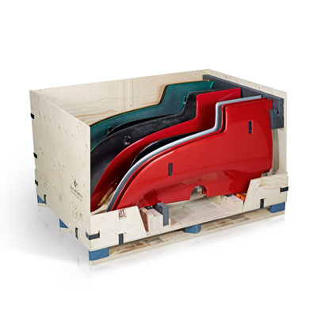
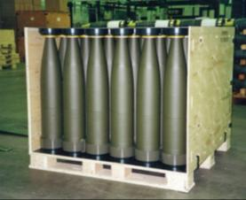
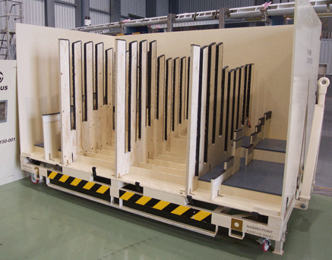
Clip-Lok International Ltd.
Global packaging Group
Reusable and collapsible packaging
Production, sales and marketing in 4 continents
Europe, US, Africa, Asia,
More than 20 years experience
Key Segments
Defence
Automotive
Aeronautical

Slide 5
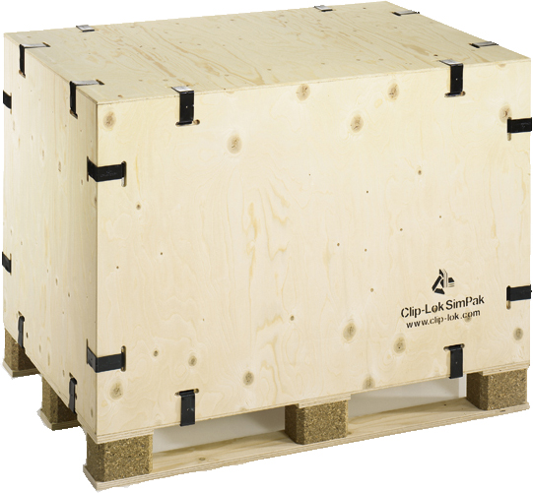
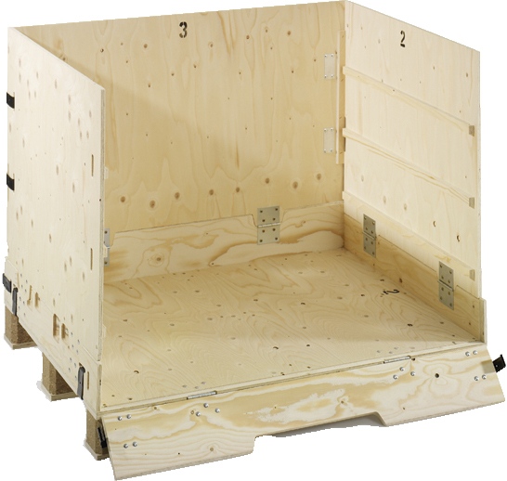
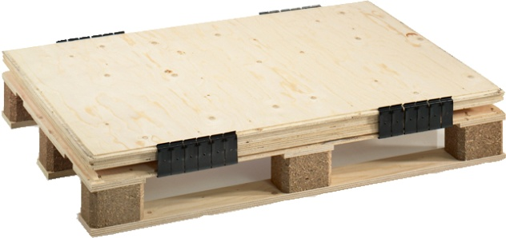
Products and services
Collapsible reusable boxes
Standard Boxes
2P Boxes
Made of plywood
FCS , PEFC and ISPM15 certified
Strong and flexible
Spring steel clips
No need for special tool
Easy to maintain
Dunnage
Services
Feasibility study
Engineering

Slide 6
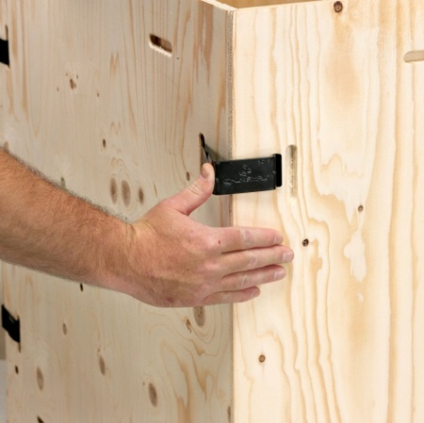
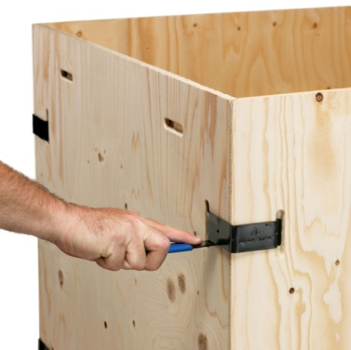
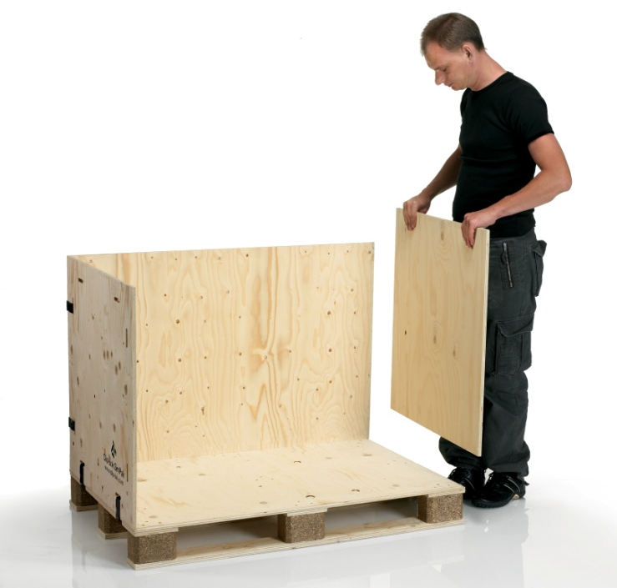
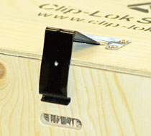
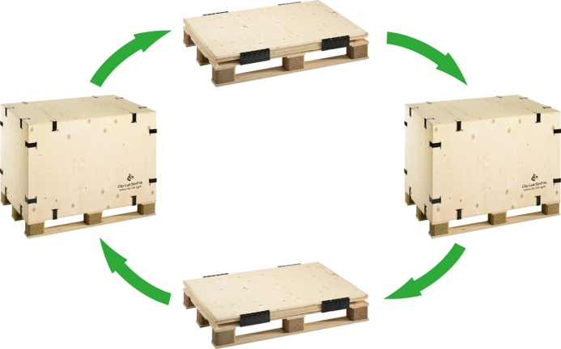
Clip-Lok System
Fast and easy handling
Can be assembled by one person in a few minutes
Can be dismantled with a simple tool
Low maintenance costs
All parts can be replaced individually
On 2P box the clip is retained in it´s position
Low environmental impact

Slide 7
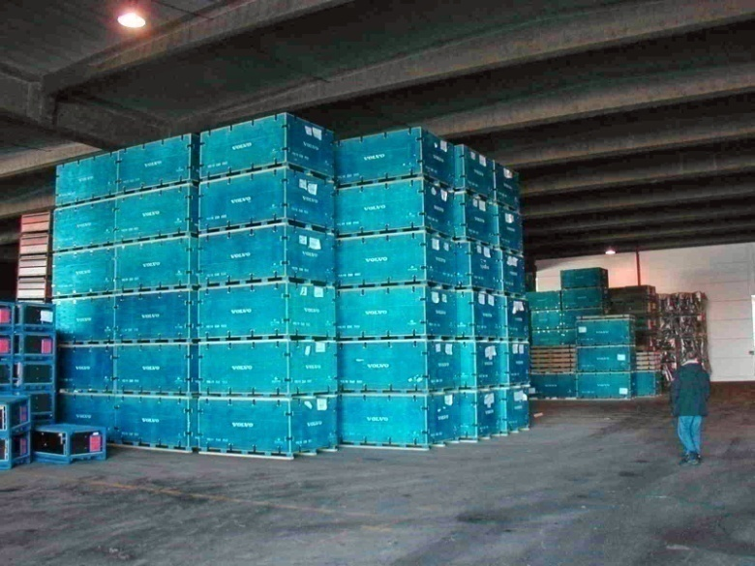
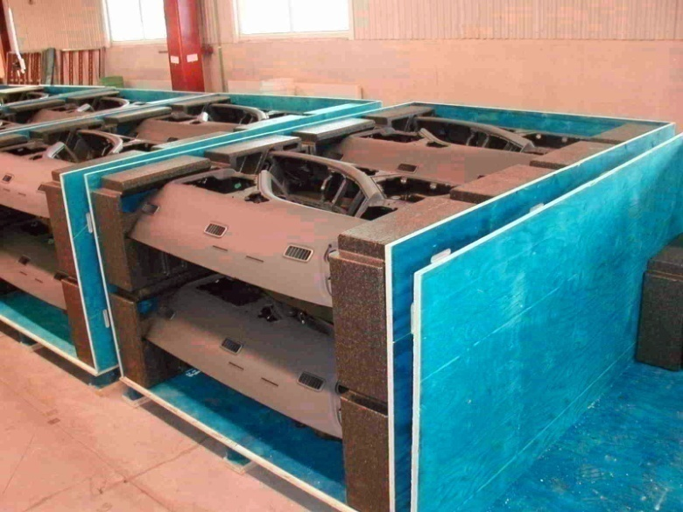
Clip-Lok System
The boxes can be stacked
Stacking of boxes save space and costs
Boxes can be collapsed and stacked
Up to 80% volume reduction pr. box
Save costs
The boxes can be a part of the production line
Optimises the flow and save time

Slide 8
Solutions for the aircraft industry
Designed by Clip-Lok

Slide 9
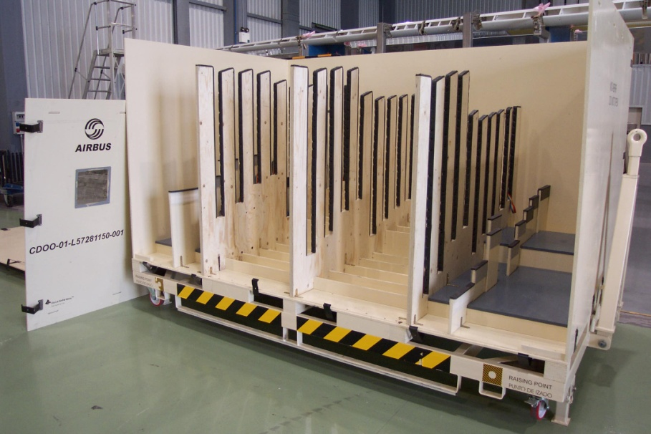
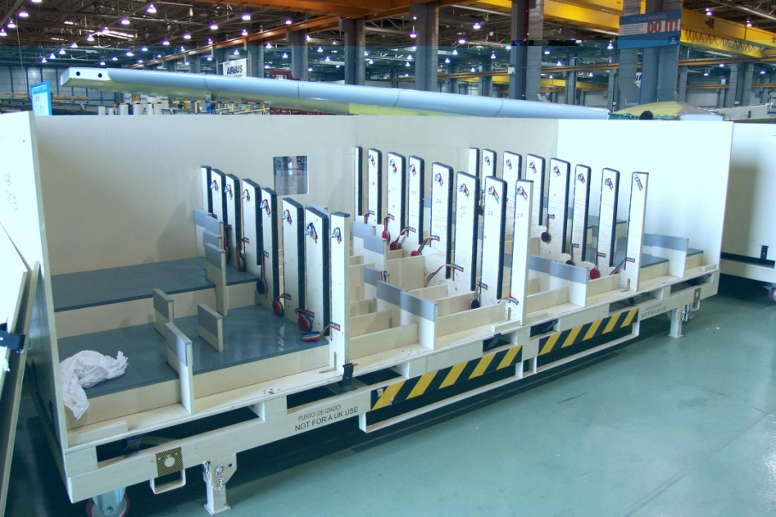
Airbus 380
For tail wing parts
To ease the handling of the parts all panels can be individually removed if nescessary
The side has a window for easy control of parts when in storage
Dunnage is designed to obtain optimal protection of the parts and stability during transport

Slide 10
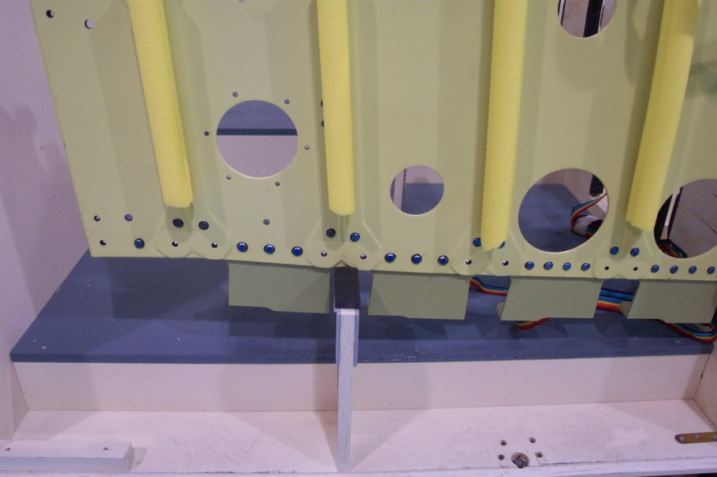
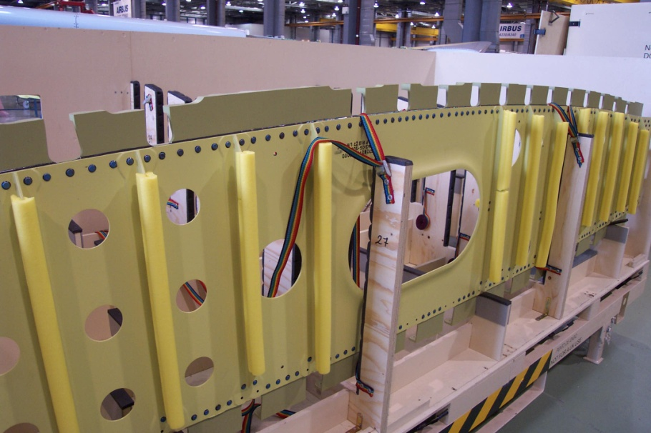
Airbus 380
To avoid scratches during trans-port the parts are separated with special designed dunnage
The dunnage is designed in plywood with protective foam
The parts are secured with quick straps to ease handling

Slide 11
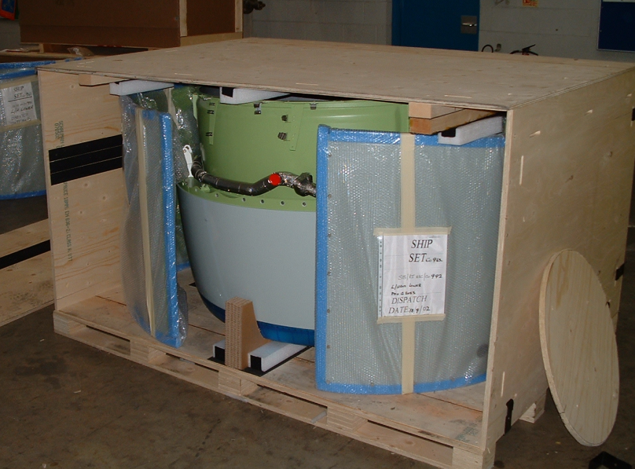
Aero components
Examples
Thrust Reversers
Nose crowl
Exhaust pipe and external side panels included in the box
Excellent packing density is achieved
Simple dunnage secure the parts

Slide 12
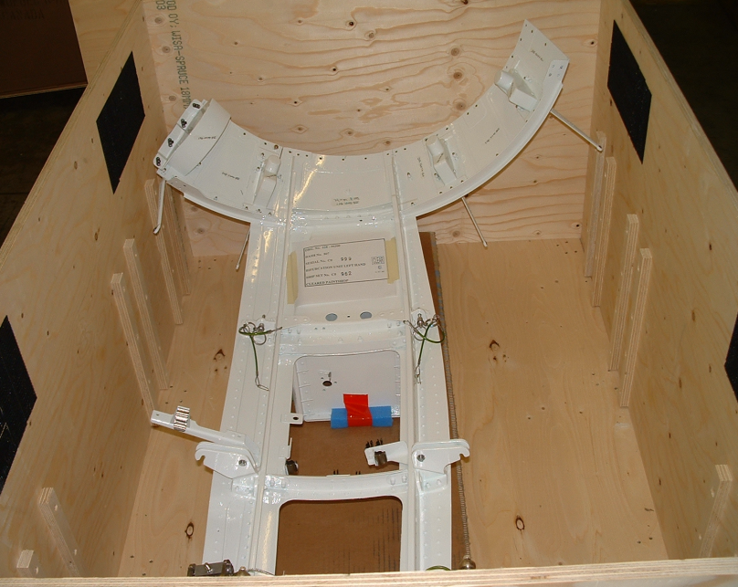
Aero components
Examples
Fixes sides panels (Prototype box)
Optimum packaging density
Optimum protection
Burification (Prototype box)
The box also contains electronic units and other parts for sampling

Slide 13
Dunnage
Correct design of dunnage is of high importance to ensure optimum protection

Slide 14
Dunnage
Correct dunnage optimises the space usage
The type of dunnage depends on the items to be transported and the way of transport
Clip-Lok uses different kinds of dunnage
plywood, steel, plastic, foam etc.

Slide 15
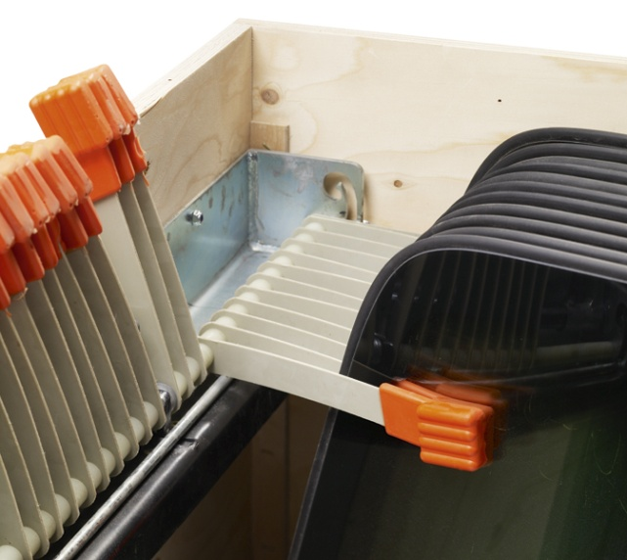
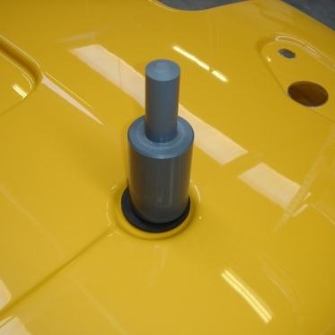
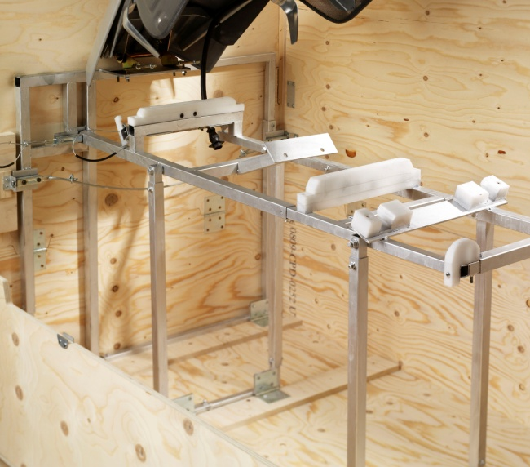
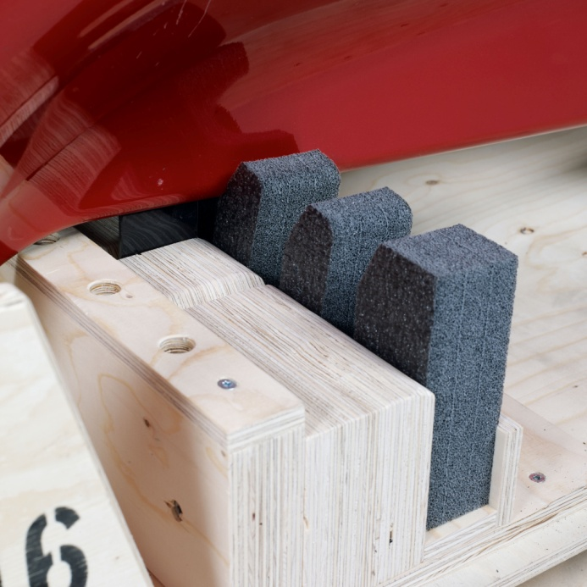
Dunnage
Combination of various materials
Special designed for each assignment
Optimised space usage
Self supported construction
Steel constructions
Integrated dunnage
Supportive blocks

Slide 16
Engineering and Service

Slide 17
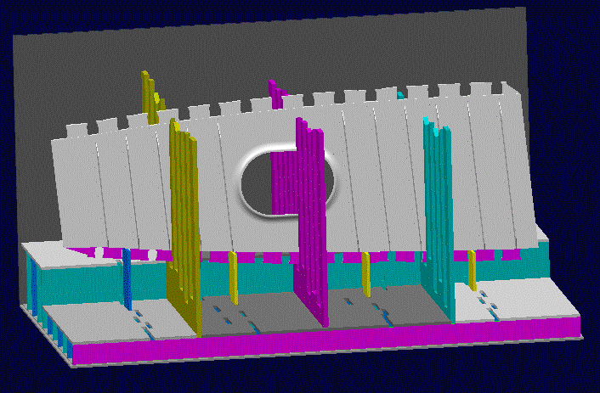
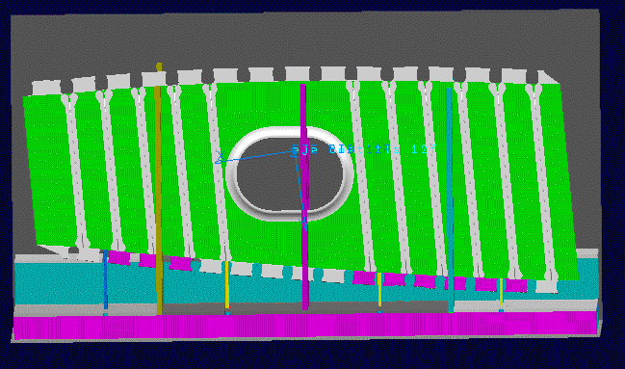
Catia integrated development
The box design is simulated in Catia 3D program
The systems allow us to conclude packing density without physical parts
The system allows fast handling of inquiries
Based on the simulation and knowledge a prototype can be ordered for testing

Slide 18
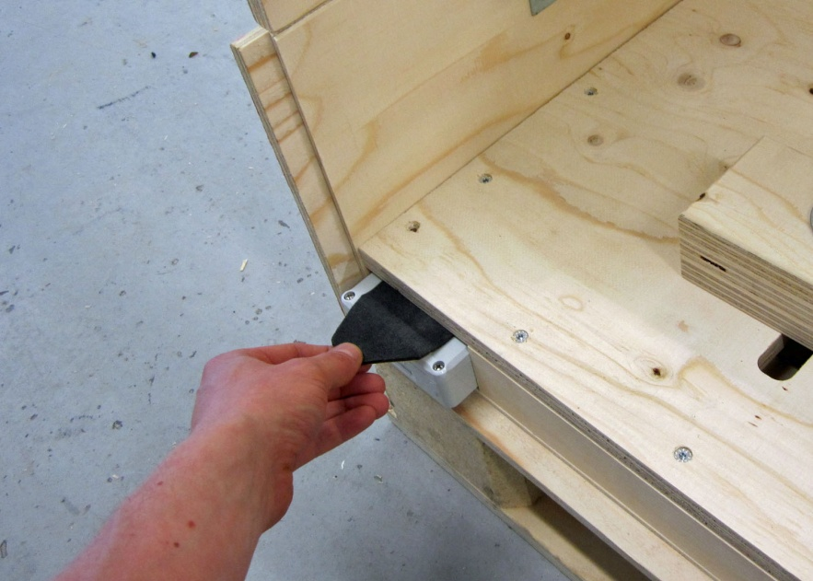
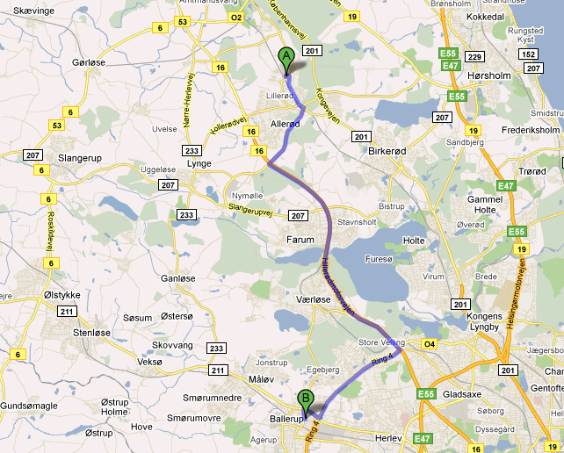
Tracking systems
GPS
We can adapt GPS senders to our boxes for you to have the most modern tracking system
Radio Frequency Identification (RFID)
We can adapt RFID tags to our boxes for you to have a modern tracking system

Slide 19
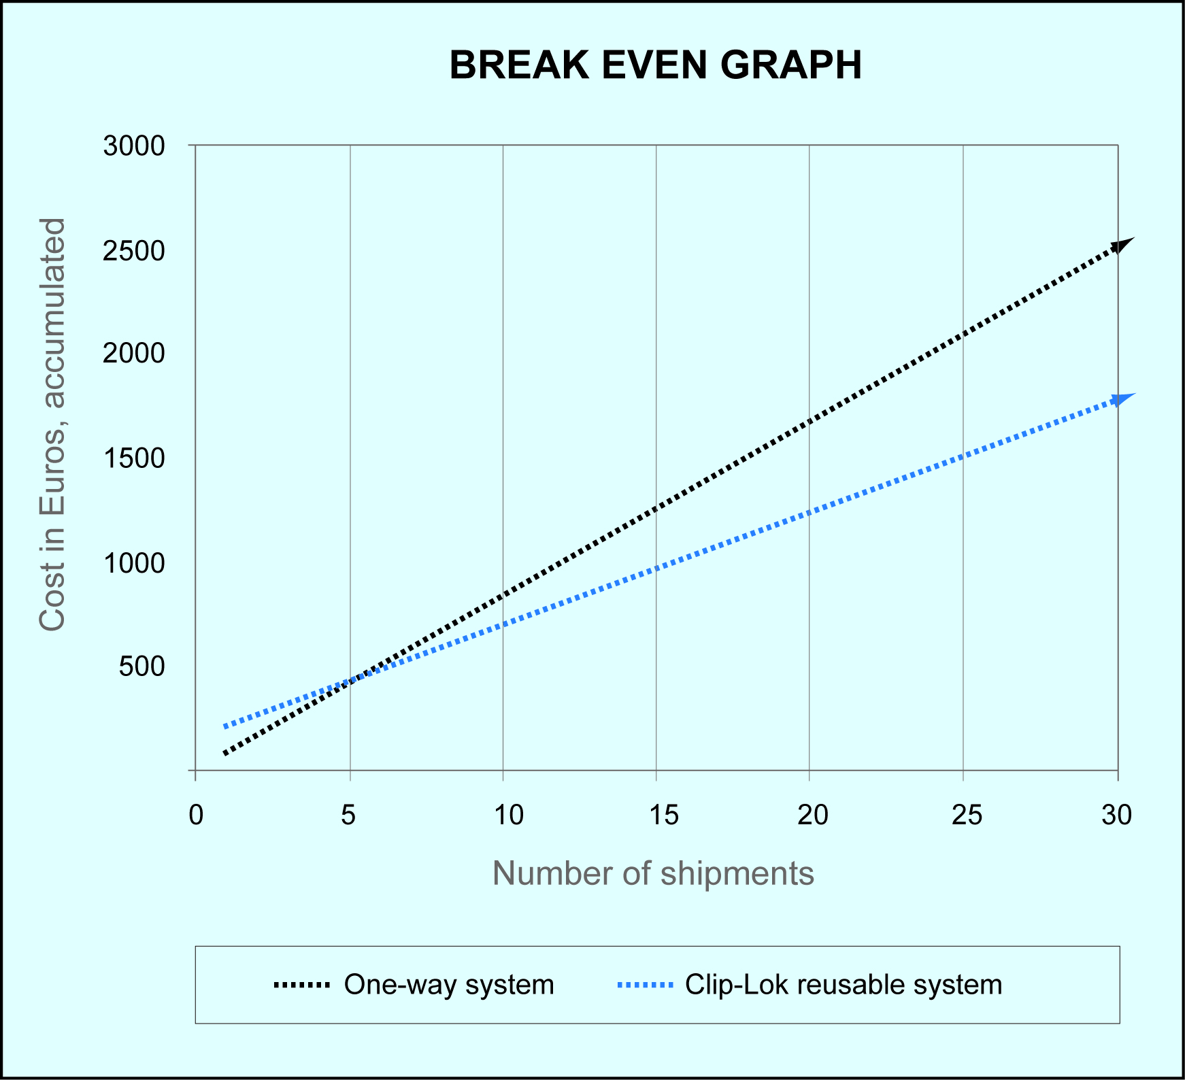
Feasibility study
Clip-Lok is able to calculate:
Your cost savings when using reusable Clip-Lok system instead of one-way boxes
Break even point
The possibilities to increase the numbers of parts and boxes per shipment
Potential cost savings when optimum dunnage is designed

Slide 20
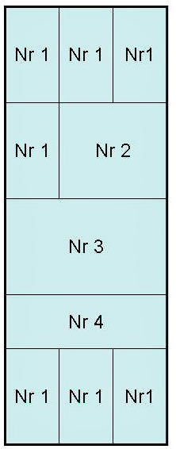
Pack plans
Pack plans can be provided upon request
Boxes can be designed to match all kind of transport methods

Slide 21
Contact
Clip-Lok SimPak (Scandinavia) ApS
Solvang 25
3450 Allerød
Tlf.: +45 48 14 37 78
info@clip-lok.com
www.clip-lok.com

